Slide 1
Unit 4 Computer Organization
Department of Computer Engineering, PCCOE

Slide 2
Outline
Functional Components
Processing unit
Input/Output subsystem
Memory Subsystem
Department of Computer Engineering, PCCOE
28

Slide 3
Functional Units
A computer consists of three main parts:
A processor (CPU)
A main-memory system
An I / O system
The CPU consists of a control unit, registers, the
arithmetic and logic unit, the instruction execution unit, and the interconnections among these components
The information handled by a computer
Instruction
Govern the transfer information within a computer as well as between the computer and its I / O devices
Specify the arithmetic and logic operations to be performed
Data
Numbers and encoded characters that are used as operands by the instructions
Department of Computer Engineering, PCCOE
28

Slide 4
Main Memory System
Address Data/Instruction
Central Processing Unit (CPU)
Cache memory
Operational Registers
Arithmetic and
Logic Unit
Instruction Sets
Program Counter
Control Unit
Input/Output System
Department of Computer Engineering, PCCOE
28

Slide 5
Program
A list of instructions that performs a task is called a program
The program usually is stored in a memory called program memory
The computer is completely controlled by the stored
program, except for possible external interruption by an operator or by I / O devices connected to the machine
Information handled by a computer must be encoded in a suitable format. Most present-day hardware employs digital circuits that have only two stable states, 0 (OFF)
and 1 (ON)
Department of Computer Engineering,PCCOE
28

Slide 6
Memory Unit
Memory
The storage area in which programs are kept when they are running and that contains the data needed by the running programs
Types of memory
Volatile memory: It is a type of memory that maintains its data only while the device is powered. If the power is interrupted for any reason, the data is lost. Volatile memory is used extensively in computers - ranging from servers to laptops -- as well as in other devices, such as printers, LCD displays, routers, cell phones, wearables and medical equipment.
28

Slide 7
*Nonvolatile memory:
Non-volatile memory (NVM) is a type of computer memory that has the capability to hold saved data even if the power is turned off. Unlike volatile memory, NVM does not require its memory data to be periodically refreshed. It is commonly used for secondary storage or long-term consistent storage.
Non-volatile memory is highly popular among digital media; it is widely used in memory chips for USB memory sticks and digital cameras. Non-volatile memory eradicates the need for relatively slow types of secondary storage systems, including hard disks.
*Usually, a computer has two classes of storage
Primary memory and secondary memory
Primary memory
Also called main memory. Volatile memory used to hold
programs while they are running; typically consists of DRAM in today’s computers

Slide 8
Memory Unit
Secondary memory
Nonvolatile memory used to st ore programs and data between runs; typically consists of magnetic disks in today’s computers
The memory consists of storage cells, each capable of storing one bit of information
The storage cells are processed in groups of fixed size called words
To provide easy access to any word in the memory, a distinct address is associated with each word location
The number of bits in each word is often referred to as the word length of the computer
Typical word length from 16 to 64 bits
The capacity of the memory is one factor that characterizes the size of a computer
Department of Computer Engineering, PCCOE
28

Slide 9
Memory Unit
Instruction and data can be written into the memory or read out under the control of the processor
It is essential to be able to access any word location in the memory as quickly as possible
Memory in which any location can be reached in a short and fixed amount of time after spec ifying its address called random- access memory (RAM)
The time required to access one word is called the memory access time
This time is fixed, independent of the location of the word being accessed
Department of Computer Engineering,PCCOE
28

Slide 10
Arithmetic and Logic Unit
Most computer operations are performed in the arithmetic and logic unit (ALU) of the processor
For example, consider two numbers stored in the memory are to be added
They are brought into the processor, and the actual addition is carried out by the ALU. Then sum may be stored in the memory or retained in the processor for immediate use
Typical arithmetic and logic operation
Addition, subtraction, multiplication, division, comparison, complement, etc.
When operands are brought into the processor, they are stored in high-speed storage elements called registers.
Each register can store one word of data
Department of Computer Engineering,PCCOE
28

Slide 11
Control Unit
The control unit is the nerve center that sends control signals to other units and senses their states
Thus the control unit serves as a coordinator of the memory, arithmetic and logic, and input / output units
The operation of a computer can be summarized as follows:
The computer accepts information in the form of programs and data through an input unit and stores it in the memory
Information stored in the memo ry is fetched, under program control, into an ALU, where it is processed
Processed information leaves the computer through an output unit
All activities inside the machine are directed by the control unit
Department of Computer Engineering,PCCOE

Slide 12
Computer Components: Top-Level View
Memory
Input/Output
System Bus
MAR
MDR
Control
PC
R₀
R₁
. . .
^{R}n-1
Processor
IR
ALU
n general purpose registers
Department of Computer Engineering,PCCOE

Slide 13
Interrupt
Normal execution of programs may be preempted if some device requires urgent servicing
To deal with the situation immediately, the normal
execution of the current program must be interrupted
Procedure of interrupt operation
The device raises an interrupt signal
The processor provides the requested service by executing an appropriate interrupt-service routine
The state of the processor is first saved before servicing the interrupt
□ Normally, the contents of the PC, the general registers, and some control information are stored in memory
When the interrupt-service routine is completed, the state of the processor is restored so that the interrupted program may
continue
Department of Computer Engineering,PCCOE

Slide 14
Classes of Interrupts
Program
Generated by some condition that occurs as a result of an
instruction execution such as arithmetic overflow, division by zero, attempt to execute an illegal machine instruction, or reference outside a user’s allowed memory space
Timer
Generated by a timer within the processor. This allows the
operating system to perform cert ain functions on a regular basis
I / O
Generated by an I / O controller, to signal normal completion of an operation or to signal a variety of error conditions
Hardware failure
Generated by a failure such as po wer failure or memory parity error
Department of Computer Engineering,PCCOE

Slide 15
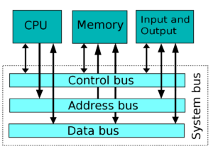
Interconnection Between Functional Components
The functional components usually use a bus architecture for communication.
A bus is a collection of wires used for the communication of different parts of a computer.
Further, it uses electric signals to pass the data and information.
Bus Architecture
Department of Computer Engineering,PCCOE

Slide 16
Different Types of Buses used are:
1. Address Bus
The address bus is used to communicate the address of the given data and instructions.
2.Data Bus
The data bus is used to communicate the data from one part to another.
3.Control Bus
The control bus is used to control the signals between different devices. Therefore, in conclusion, we can say that these functional components communicate through this bus architecture. The input device takes the input, then the data is processed and the output devices display the results. Besides, the system bus performs all the communication that the cycle involves.
Department of Computer Engineering,PCCOE

Slide 17
Bus Structures
A group of lines that serves a connecting path for several devices is called a bus
In addition to the lines that carry the data, the bus must have lines for address and control purposes
The simplest way to interconnect functional units is to use a single bus, as shown below
Input
Output
Memory
Processor
Department of Computer Engineering,PCCOE

Slide 18
Processor Organization
To understand the organization of the CPU, let us consider the requirements placed on the CPU, the things that it must do:
Fetch instruction: The CPU reads an instruction from memory.
Interpret instruction: The instruction is decoded to determine what action is required.
Fetch data: The execution of an instruction may require reading data from memory or an I/O module.
Process data: The execution of an instruction may require performing some arithmetic or logical operation on data.
Write data: The results of an execution may require writing data to memory or an I/O module.
To do these things, it should be clear that the CPU needs to store some data temporarily. It must remember the location of the last instruction so that it can know where to get the next instruction. It needs to store instructions and data temporar­ily while an instruction is being executed. In other words, the CPU needs a small internal memory.
Department of Computer Engineering,PCCOE

Slide 19
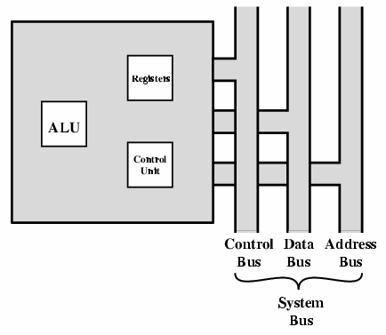
Fig 1: The CPU with the System Bus
Department of Computer Engineering,PCCOE

Slide 20
Figure 1 is a simplified view of a CPU, indicating its connection to the rest of the system via the system bus.
Major components of the CPU are an arithmetic and logic unit (ALU) and a control unit (CU). The ALU does the actual computation or processing of data.
The con­trol unit controls the movement of data and instructions into and out of the CPU and controls the operation of the ALU.
In addition, the figure shows a minimal internal memory, consisting of a set of storage locations, called registers.
Department of Computer Engineering,PCCOE

Slide 21
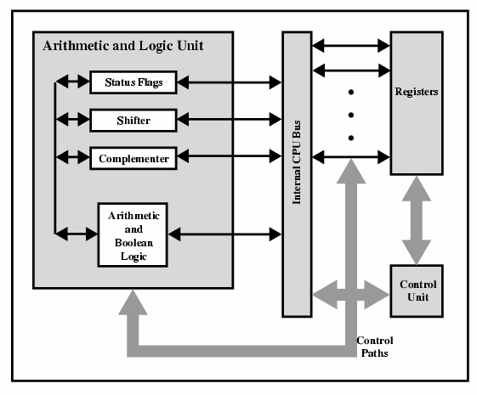
Given Figure is a slightly more detailed view of the CPU. The data transfer and logic control paths are indicated, including an element labeled internal CPU-bus. This element is needed to transfer data between the various registers and the ALU because the ALU in fact operates only on data in the internal CPU mem­ory.
Figure : CPU Internal Structure
Department of Computer Engineering,PCCOE

Slide 22
2. Register Organization
Within the CPU, there is a set of registers that function as a level of memory above main memory and cache in the hierarchy. The registers in the CPU perform two roles:
User-visible registers: These enable the machine- or assembly-language pro­grammer to minimize main memory references by optimizing use of registers.
Control and status registers: These are used by the control unit to control the operation of the CPU and by privileged, operating system programs to control the execution of programs.
There is not a clean separation of registers into these two categories. For example, on some machines the program counter is user visible (e.g., Pentium), but on many it is not (e.g., PowerPC). For purposes of the following discussion, how­ever, we will use these categories.
Department of Computer Engineering,PCCOE

Slide 23
2.1 User-Visible Registers
A user-visible register is one that may be referenced by means of the machine lan­guage that the CPU executes. We can characterize these in the following categories:
General purpose
Data
Address
Condition codes
General-purpose registers: can be assigned to a variety of functions by the pro­grammer. Sometimes their use within the instruction set is orthogonal to the opera­tion. That is, any general--purpose register can contain the operand for any opcode. This provides true general-purpose register use. Often, however, there are restric­tions. For example, there may be dedicated registers for floating-point and stack operations. In some cases, general-purpose registers can be used for addressing functions (e.g.. register indirect, displacement). In other cases, there is a partial or clean sep­aration between data registers and address registers.
Department of Computer Engineering,PCCOE

Slide 24
Data registers may be used only to hold data and cannot be employed in the calculation of an operand address.
Address registers may themselves be somewhat general purpose, or they may be devoted to a particular addressing mode. Examples include the following:
Segment pointers: In a machine with segmented addressing, a segment register holds the address of the base of the segment. There may be multiple registers: for example, one for the operating system and one for the current process.
Index registers: These are used for indexed addressing and may be auto-indexed.
Stack pointer: If there is user-visible stack addressing, then typically the stack is in memory and there is a dedicated register that points to the top of the slack. This allows implicit addressing; that is, push, pop, and other slack in­structions need not contain an explicit stack operand.
Department of Computer Engineering,PCCOE

Slide 25
2.2 Control and Status Registers
There are a variety of CPU registers that are employed to control the operation of the CPU. Most of these, on most machines, are not visible to the user. Some of them may be visible to machine instructions executed in a control or operating system mode.
Of course, different machines will have different register organizations and use different terminology. We list here a reasonably complete list of register types, with a brief description.
Four registers are essential to instruction execution:
Program counter (PC): Contains the address of an instruction to be fetched.
Instruction register (IR): Contains the instruction most recently fetched.
Memory address registers (MAR): Contains the address of a location in memory.
Memory buffer register (MBR): Contains a word of data lo be written to mem­ory or the word most recently read.
Department of Computer Engineering,PCCOE

Slide 26
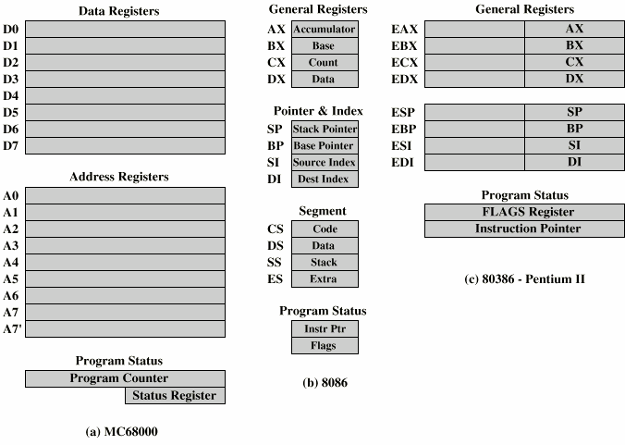
A number of other registers related to status and control might be found in a particular CPU design. In addition to the PSW, there may be a pointer to a block of memory containing additional status information (e.g., process control blocks).
Example Register Organizations:
Department of Computer Engineering,PCCOE

Slide 27
3. Instruction Cycle
Recall that the instruction cycle includes the following sub-cycles:
Fetch: Read the next instruction from memory into the CPU.
Execute: Interpret the opcode and perform the indicated operation.
Interrupt: If interrupts are enabled and an interrupt has occurred, save the current process state and service the interrupt.
We are now in a position to elaborate somewhat on the instruction cycle. First, we must introduce one additional sub-cycle, known as the indirect cycle.
Department of Computer Engineering,PCCOE

Slide 28
Data Path in a CPU
The CPU can be divided into two sections: the data section and the control section. The DATA section is also known as the data path.
BUS: In early computers “BUS” were parallel electrical wires with multiple hardware connections. Therefore a bus is a communication system that transfers data between components inside a computer, or between computers. It includes hardware components like wires, optical fibers, etc and software, including communication protocols. The Registers, ALU, and the interconnecting BUS are collectively referred to as data paths.
Department of Computer Engineering,PCCOE

Slide 29
Types of the bus are:
Address bus: The buses which are used to carry address.
Data bus: The buses which are used to carry data.
Control bus: If the bus is carrying control signals.
Department of Computer Engineering,PCCOE

